Slide 1

Implementing the ECU
Diversity & Inclusion
Capability Maturity Model
School of Business & Law
(ECU D&I CMM)

Slide 2

“…without a modern, diverse and inclusive workforce, one that not only represents differences but where people of all identities can contribute as full and valued members, public sector organisations
will fail to leverage the wealth of benefits offered.”
Lundy, J. (2022, January 19). Optimising inclusion and diversity in the public sector: an evidence-based approach. The Mandarin. https://www.themandarin.com.au/178943-optimising-inclusion-and-diversity-in-the-public-sector-an-evidence-based-approach/

Slide 3

What is the ECU D&I
CMM?
The ECU D&I CMM identifies relevant dimensions as well as typical maturity levels corresponding to different stages of organisational development in diversity and inclusion.

Slide 4

What is the ECU D&I
CMM?
The ECU D&I CMM allows organisations to:
  Self-assess strengths and weaknesses
  Identify the organisation’s current maturity level
  Set realistic target goals
  Plan for continuous improvement

Slide 5





ECU D&I Maturity Levels
4
transformatiVE
At Level 4, D&I is next-practice orientated. There are expanding conceptualisations of diversity, with inclusion as a core element.
integrative
3
At Level 3 D&I reflects interactions between people and processes, with inclusion becoming an integral and integrating component.
managerial
2
At Level 2, diversity is primarily for organisational advantage. Inclusion is espoused, not enacted.
ECU
D&I CMM Dimensions
compliance
Drivers &
Focus
At Level 1, D&I is legalistic, HR-dominant and reactive. It is largely (if not solely) related to diversity.
1
Responsibility & Leadership
D&I
Measurement
Mechanisms & Defining Features

Slide 6
What Is Involved?
Conducting an ECU D&I CMM Self-Assessment
The assessment process has four steps:
  Preparing for the self-assessment (decide on the scope of the assessment and who needs to be involved)
  Conducting the self-assessment (using the Excel-based tool available, assess the current maturity levels for each dimension using organisational evidence and set realistic target ratings)
  Analysing and reporting the results (review the radar chart produce by the self-assessment tool and review the evidence collected, the gaps and alignments)
  Planning for continuous improvement (decide on where to invest resources for the greatest impact)

Slide 7
Preparing for the Self-Assessment
Define the scope
Decide the best format
Identify who is involved
The whole organisation
Particular work units/departments
Limited to a specific diversity type (e.g. gender, age, neurodiversity)
Complete the self-assessment as a team in a workshop format
Arrange for individual work units/departments to complete and return to the D&I self-assessment project coordinator
  Which managers/senior leaders should be involved?
  How will we identify appropriate staff representatives?
  How will we engage staff? (e.g., focus groups, an anonymous survey, interviews)

Slide 8
ECU D&I Critical Planning Questions
Why do diversity and inclusion matter to us personally?
Where do we want to go?
How do we ensure the voices of the most marginalised in our organisation are included?

Slide 9
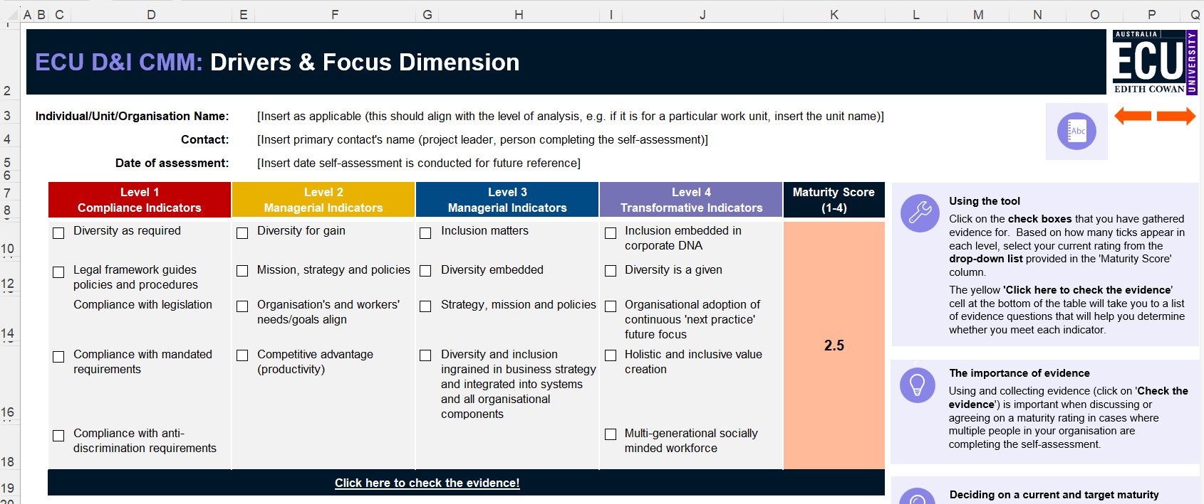

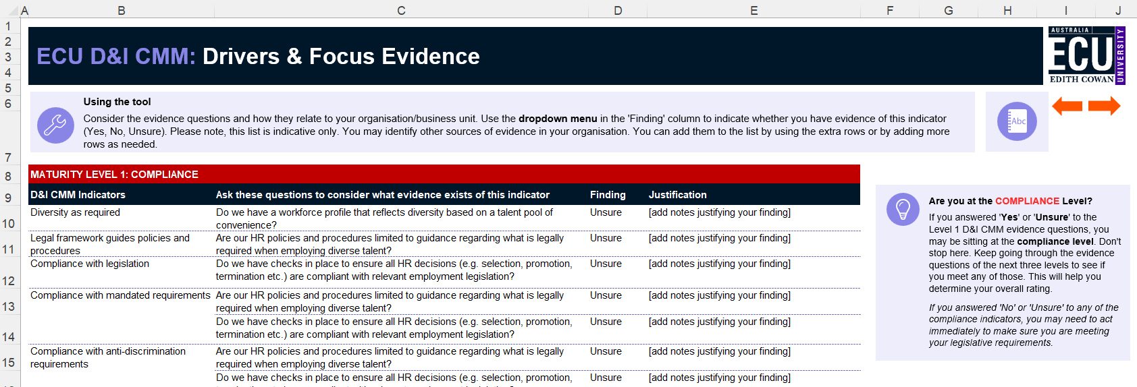

Conducting the Self-Assessment
Depending on the scope and format chosen, using the ECU D&I CMM Self-Assessment Excel Tool, complete the self-assessment
Refer to the evidence examples in the tool to help assess the current organisation/unit maturity for each dimension

Slide 10
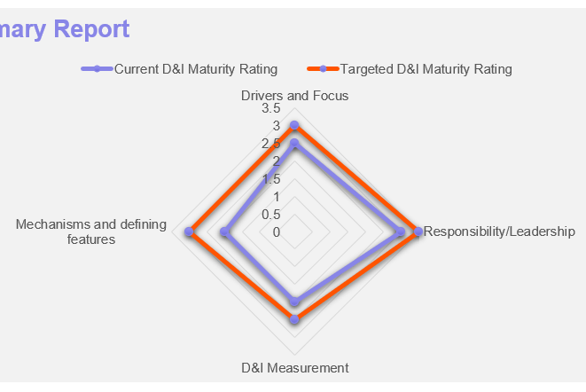
Analysing & Reporting the Results
Summary Report
Decide on a target rating for each dimension
Use the summary report radar chart to analyse the results
Identify any gaps or alignments between where the organisation is and where it wants to be
Review the evidence tables to identify the strengths and weaknesses

Slide 11
ECU D&I Critical Reporting Questions
If the self-assessment was completed by multiple business units, are there any significant differences in current ratings across the organisation?
If there are differences, why might this be?
Do the current ratings reflect the feedback from employees who have direct experience of diversity and inclusion in our organisation?
Do we need to seek more staff feedback to better understand the results?

Slide 12


Planning for Improvement
Using the analysis from the self-assessment, identify the areas that need attention
Refer back to the evidence tables to identify potential action items that could help shift from one level to the next to meet the target rating
Consider using a planning tool to identify where best to invest time and resources – not all gaps might need to be filled immediately
Decide on a timeframe for the next self-assessment (allowing time for any strategies to be implemented)

Slide 13
ECU D&I Critical Planning for Improvement Questions
What’s our strategy?
Where do we need to standardise?
How can we connect D&I work up and down the organisation?
What is our full sphere of influence?

Slide 14


Questions?
School of
Business & Law

Slide 15
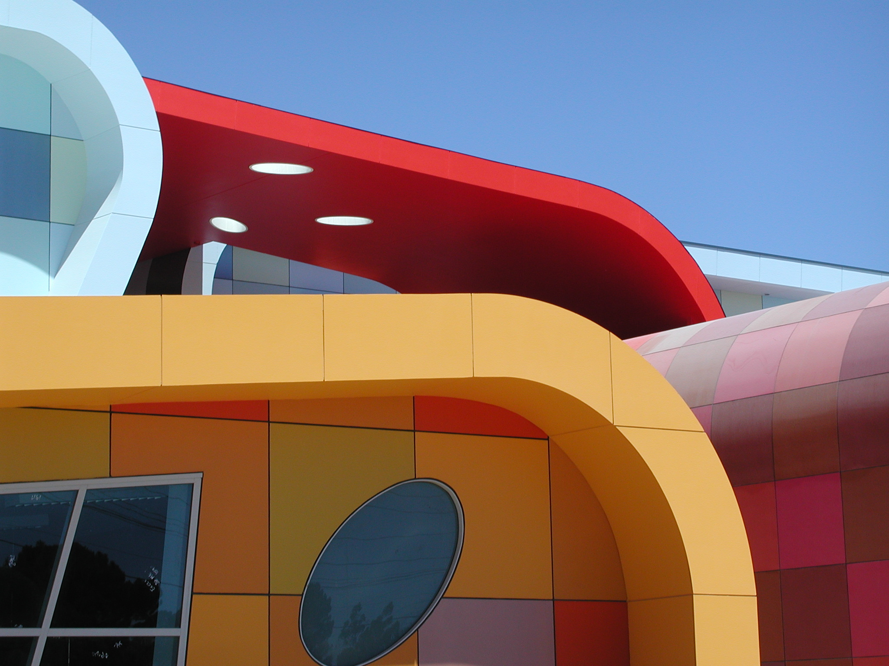
ECU
Diversity & Inclusion Capability Maturity
Model
This resource is based on the ECU Diversity & Inclusion Capability Maturity Model (ECU D&I CMM) first introduced as Figure 1 in Lundy, J., Keast, R., Farr-Wharton, B., Omari, M., Teo, S., & Bentley, T. (2021). Utilising a capability maturity model to leverage inclusion and diversity in public sector organisations. Australian Journal of Public Administration, 80(4), 1032–1045 https://doi.org/10.1111/1467-8500.12521. © 2021 Institute of Public Administration Australia.
For more information contact
Dr Judy Lundy
School of Business and Law
Edith Cowan University
j.lundy@ecu.edu.au
+61 8 6304 5140
*
*© 2021 Institute of Public Administration

