Slide 1

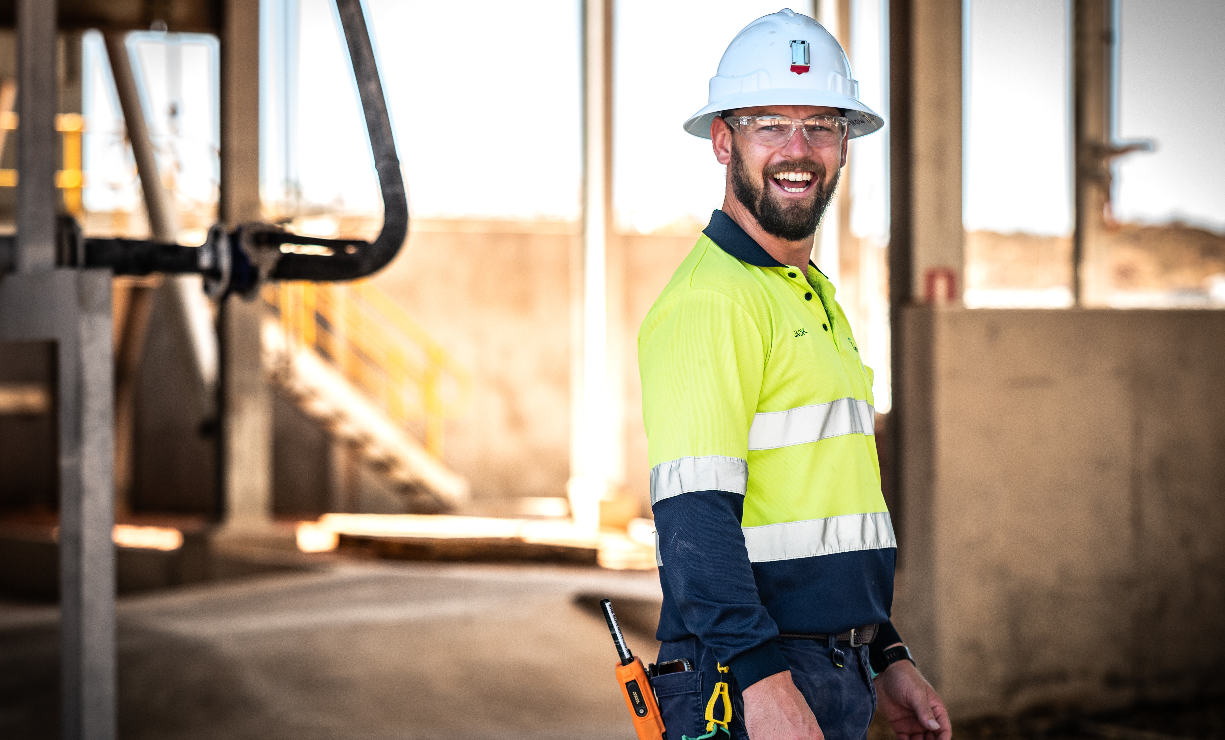

INDUSTRY SUMMARY REPORT SERIES - 2025
Positive Humour and Wellbeing in Mining
Mental Awareness, Respect and Safety (MARS) Centre Research Report

Slide 2
Summary
Abstract
This study explores the relationship between positive humour, team belongingness, and employee wellbeing within the Western Australia mining context.
Using a quantitative survey administered to both FIFO mine site workers and corporate office staff, the research identifies notable differences in stress levels and workload between the two groups. Client employees reported lower wellbeing compared to those working for business partners.
Across all groups, high levels of positive humour and team belongingness were reported, with positive humour strongly associated with higher wellbeing and stronger team connection.
These findings suggest that a supportive team culture and positive humour may be effective strategies for enhancing psychosocial safety and mental health in remote and high-risk work environments.
Dr Aglae Hernandez Grande
Dr Fleur Sharafizad
Acknowledgement to Funder
This research was conducted as part of the ECU MARS Centre’s Digging Deeper Research Program. We would like to acknowledge and thank our funder the Government of Western Australia.

Slide 3
Introduction
Research Background
The new psychosocial safety legislation requires organisations to identify and mitigate work-related factors that may negatively impact employee mental and physical wellbeing. These changes reflect growing recognition that unmanaged psychosocial hazards can contribute to psychological distress, stress, and broader health concerns.
In response, our industry partner has committed significant resources to proactively addressing these risks, particularly within the unique context of fly-in fly-out (FIFO) work.
This study draws on contemporary frameworks of workplace mental health, including Psychosocial Safety Climate (PSC; Dollard & Bakker, 2010), team belongingness, and the role of positive humour in promoting wellbeing. Research suggests that positive humour can foster connection, reduce stress, and buffer the impact of workplace adversity.
As such, this project aims to explore how positive humour and banter can impact wellbeing levels in a mining context, with the following research question:
How does positive humour impact wellbeing levels in the mining industry?
Methodology
This quantitative study used paper surveys that were personally distributed, collected, and entered by the ECU research team. Data was gathered from corporate office staff as well as employees from the mine operator and business partners who work FIFO on a remote mine site. The mine site sample included data from all workgroups on site including underground and open pit crews, processing plant staff, site services, non-process infrastructure, maintenance as well as environmental, social, and governance and work health and safety.
The research team was on-site (7–11 February 2025) and at the corporate office (26 March 2025), attending pre-start meetings and being present at shift changes to promote participation. To assess psychosocial safety, each individual was surveyed at the start and end of their shifts (including both day and night shifts). Individuals were grouped into work teams to enable multilevel statistical analysis.
To boost engagement, the study was widely promoted beforehand via posters, slides, and site notices. Participants who completed both surveys received a coffee voucher and an entry into a gift card draw.
A real-time Power BI dashboard provided site leaders with preliminary insights.
In total, 246 participants completed both surveys (59% response rate). Of these, 216 were from the mine site (60% response rate) and 30 from the corporate office (55% response rate).
3
Positive Humour and Wellbeing in Mining

Slide 4
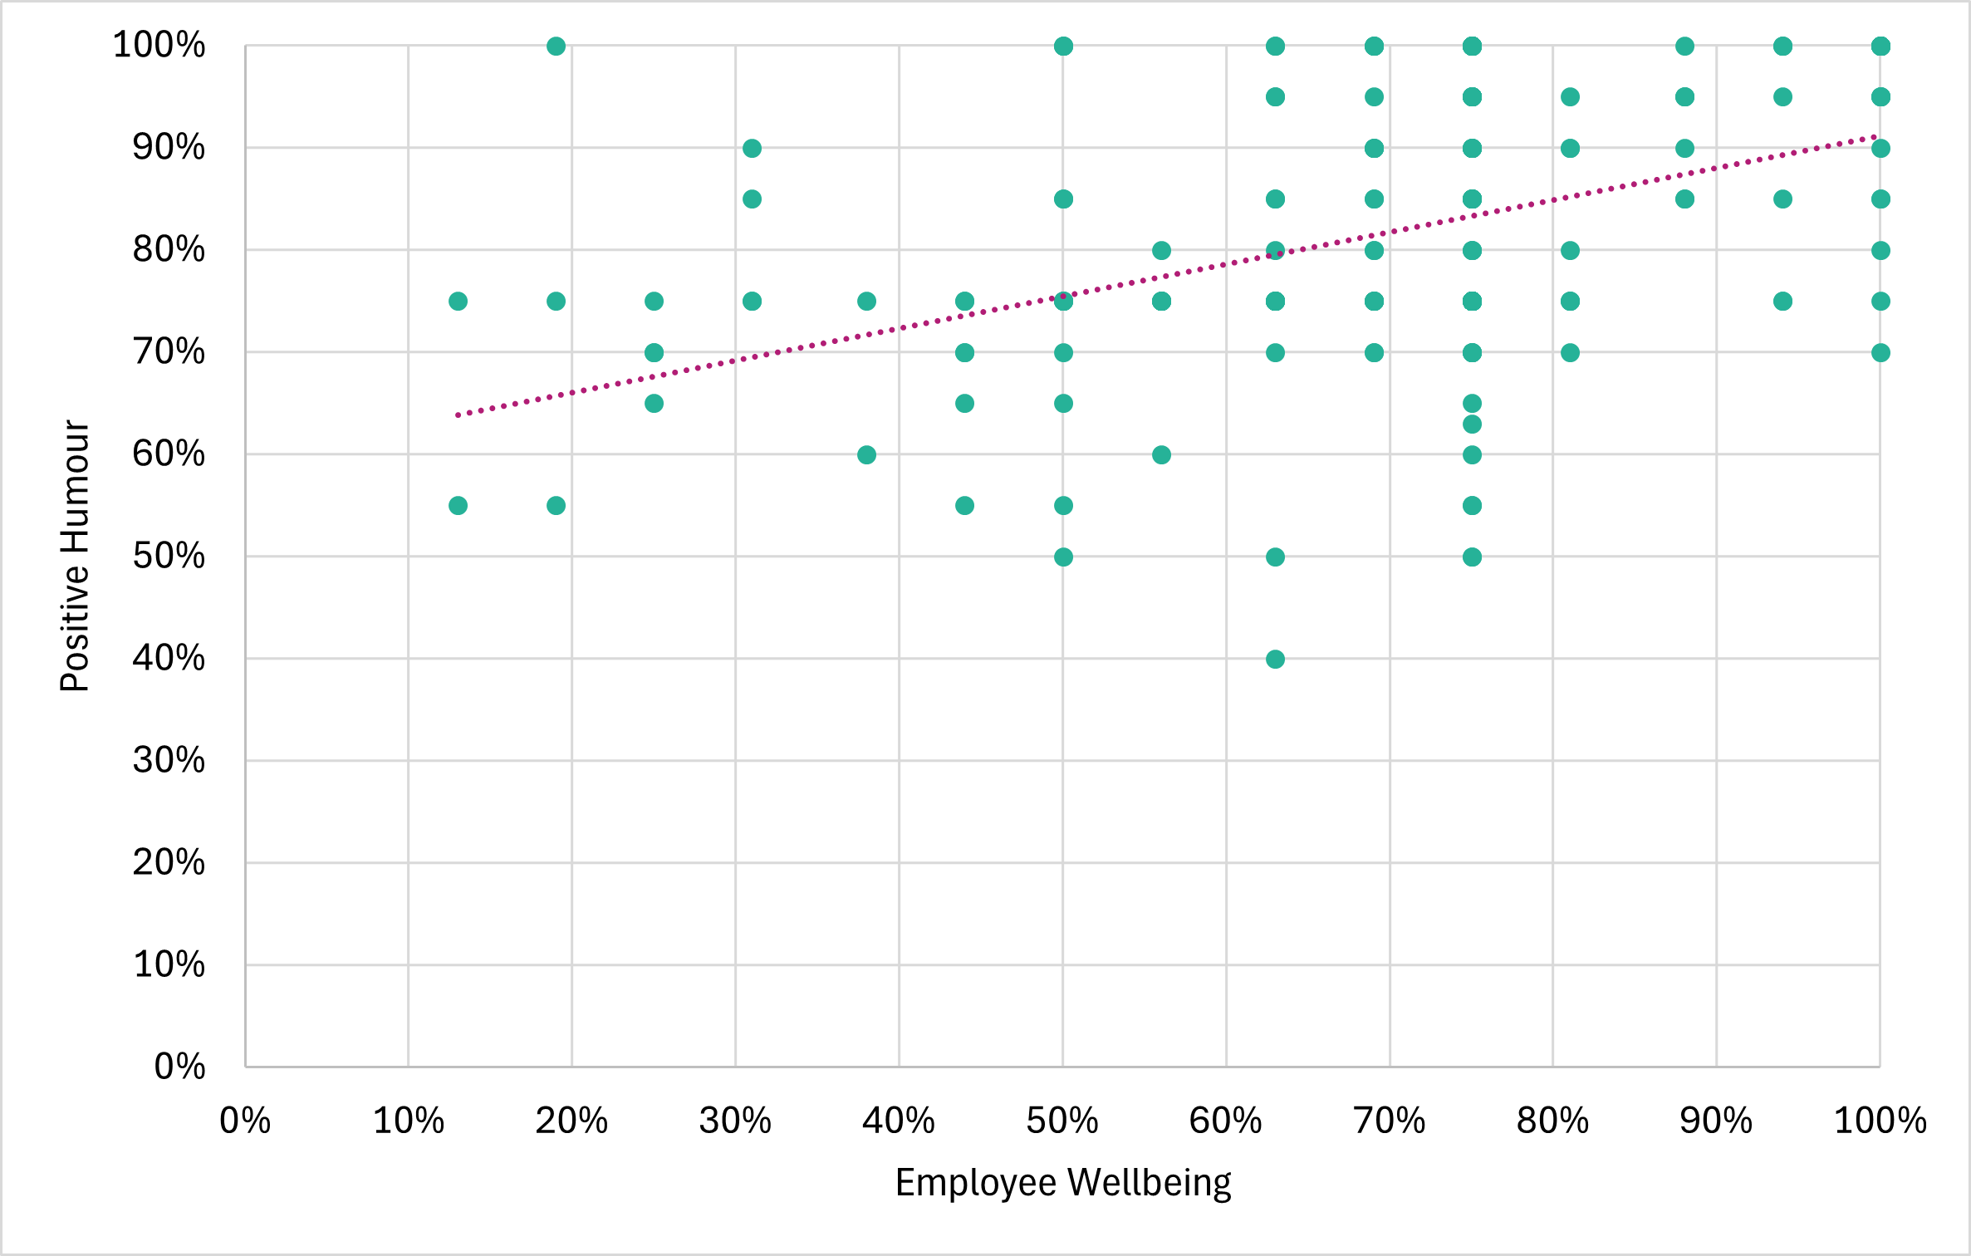
Discussion
Results
Key findings of the study highlight:
Stress levels were significantly different for those working on site (18.3% on average) and those working in the corporate office (40.5% on average). Similarly, those working on site reported significantly lower levels of quantitative demands (36.5% on average) than those working in the corporate office (51.7%). Individuals who reported an increased level of stress also had higher levels of quantitative demands, in line with organisational research.
Findings indicate that client employees reported consistently lower wellbeing scores than individuals who were working for business partner organisations.
Overall, positive humour levels and a sense of team belongingness were high at both the remote mine site (82.8% and 79.7% on average, respectively) and the corporate office (80.0% and 81.2% on average, respectively). Nobody reported low or very low levels of positive humour or team belongingness.
Individuals who reported an increased level of positive humour also had higher levels of employee wellbeing (see Figure 1). While this cannot be considered causal, positive humour and employee wellbeing appear to be related to each other. Similarly, higher levels of positive humour are also related to higher levels of team belongingness.
Figure 1. Relationship between positive humour and employee wellbeing
4
Psychosocial Safety in a FIFO context

Slide 5
Discussion
Implications for Industry
The findings of this study have generated a number of important insights and considerations for mining organisations. These include:
The study found that corporate staff reported higher stress, and work demands than site-based FIFO workers. This suggests the need for targeted wellbeing initiatives that reflect the different demands of each environment.
Client employees reported lower wellbeing than those working for business partners. This indicates potential gaps in support or culture that the client organisation should address to improve employee experience.
High levels of positive humour and team belongingness were reported across all groups. These strengths can be reinforced to maintain strong team culture and connection, especially in remote or high-pressure settings.
Positive humour was linked to higher wellbeing and team belongingness. Simple, low-cost initiatives that encourage humour, banter and camaraderie could be effective tools for improving workplace mental health.
5
Psychosocial Safety in a FIFO context

Slide 6
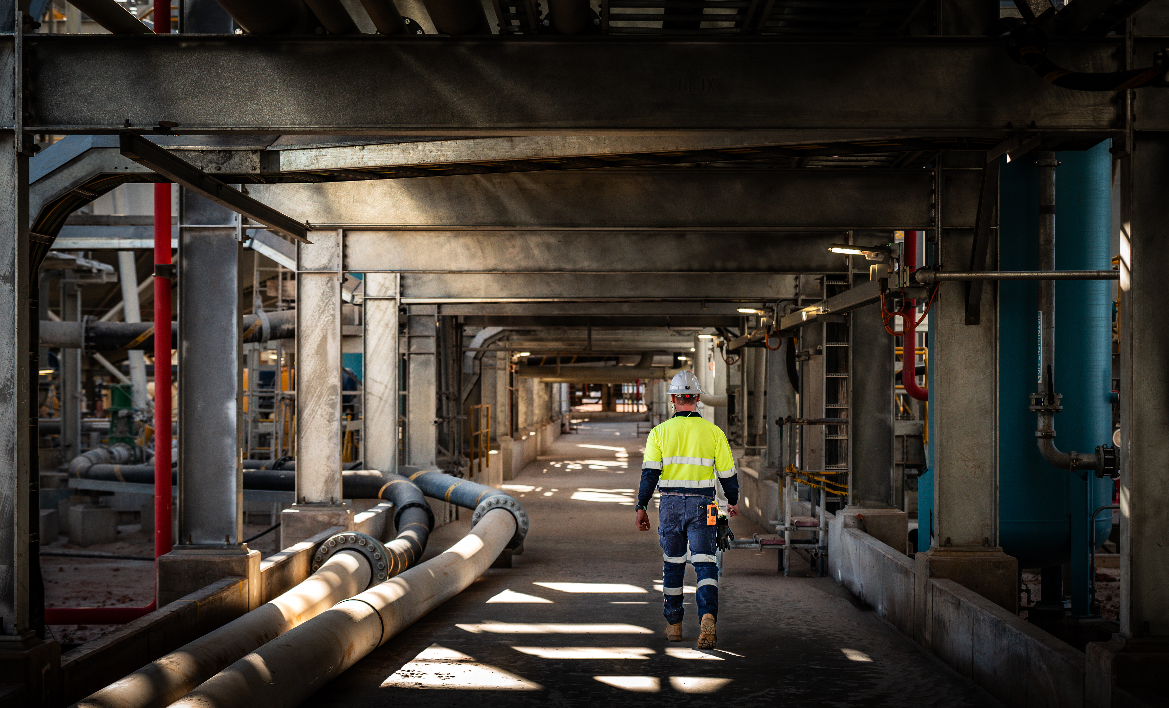
References
Dollard, M. F., & Bakker, A. B. (2010). Psychosocial safety climate as a precursor to conducive work environments, psychological health problems, and employee engagement. Journal of Occupational and Organizational Psychology, 83(3), 579–599. https://doi.org/10.1348/096317909X470690
XX
6
Psychosocial Safety in a FIFO context

Slide 7
Contact
E: mars@ecu.edu.au
W: ECU MARS Website

